Slide 1
PRESENTED BY: DEBASHIS GARAI UID - 18BCS6054
MULTIPLE LINEAR REGRESSION (MLR)

Slide 2
Practical 1 and 2 (Case Study)
DESCRIPTION: Predict cancer mortality rates for US counties.
YOUR TASK: Build a multivariate Ordinary Least Squares regression model to predict "TARGET_deathRate"

Slide 3
STEPS FOLLOWED:
1. Reading and understanding the data.
2. Data Visualisation.
3. Splitting into training and testing sets.
4. Building the model.
5. Residual analysis of the train data.
6. Making Predictions.
7. Model Evaluation.

Slide 4
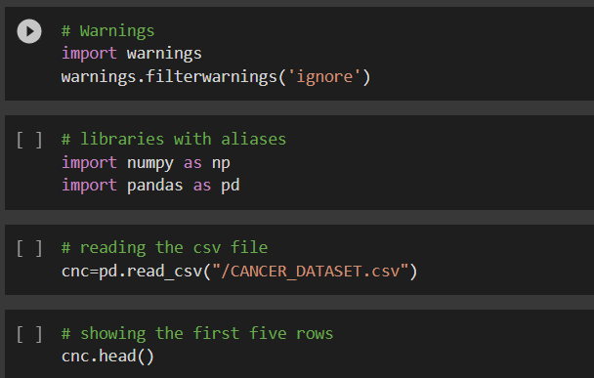
STEP 1: Reading and Understanding Data
The following tasks are performed:
Importing all the necessary libraries and warnings.
Reading the .csv file.
Checking the head count, information on the basis of ehich the columns need to be dropped.
Dropping the non - required columns for bettre analysis.
Calculating the correlation values for the specific columns.

Slide 5
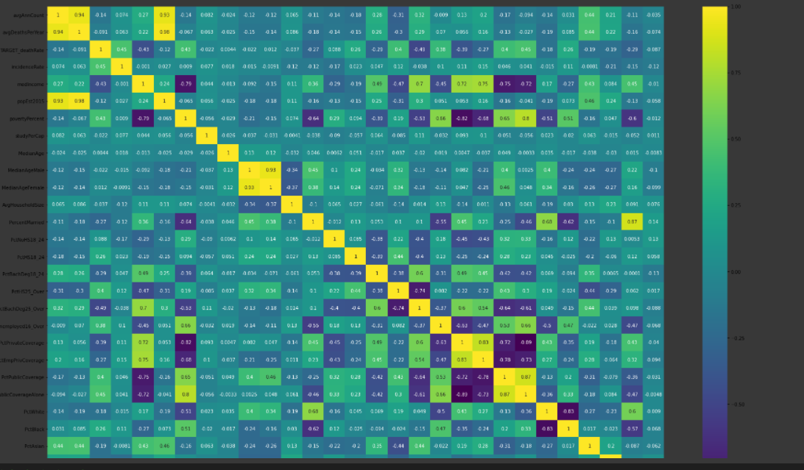
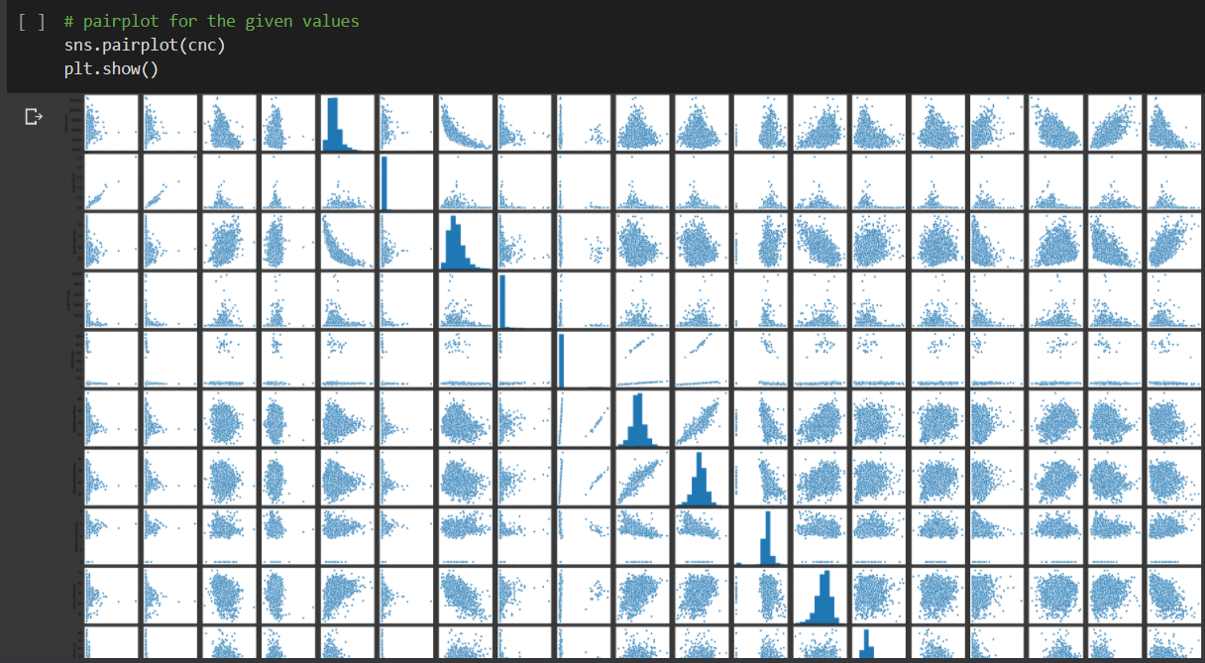
STEP 2: Data Visualisation
The tasks performed are:
Visualise with the help of heat map and pairplot to find the types of variables present in the dataset.

Slide 6
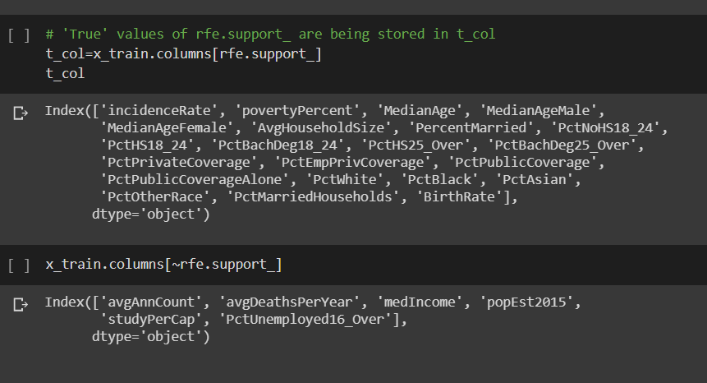
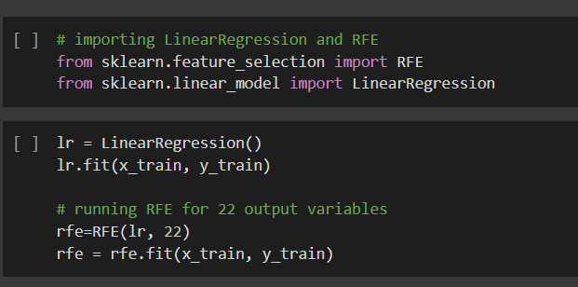
STEP 3: Training and Testing sets
The tasks performed are:
Using train_test_split of sklearn.model_selection library the dataset is divided into training and testing sets
Training is done using RFE(Recursive feature elimination) in which it selects features recursively by considering smaller set of features.

Slide 7
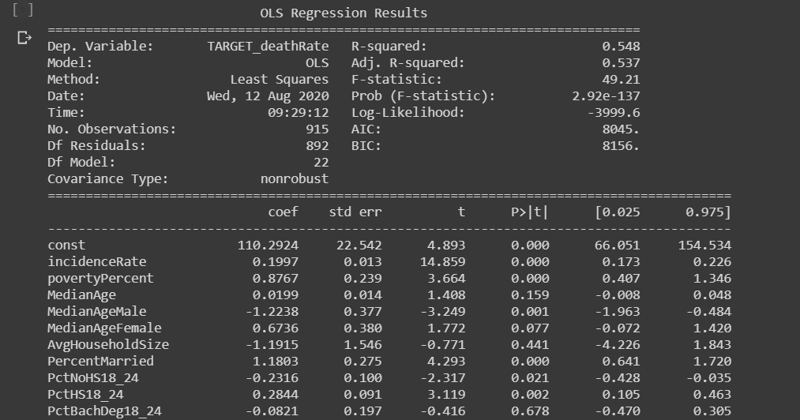
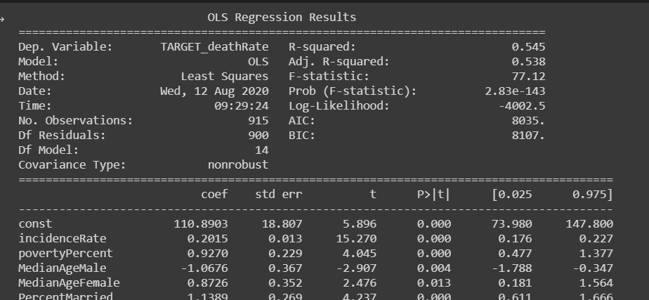
STEP 4: Building the model
The tasks performed are:
A new df x_rfe is created in which the trained data is being transferred. The obtained R-squared value is 0.490.
After removing the columns where the p>|t| value is greater than 0.050 the R-squared value is 0.486.
The R-squared value is obtained after running RFE for 22 output variables.

Slide 8
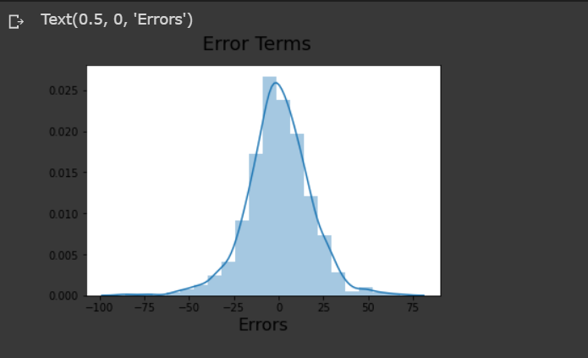
STEP 5: Residual Analysis
The tasks performed are:
A histogram for the error terms is plotted by the use of sns.distplot((y_train - y_train_deathrate), bins=20), where y_train is the trained set and y_train_deathrate is the predicted set after dropping specific columns.

Slide 9
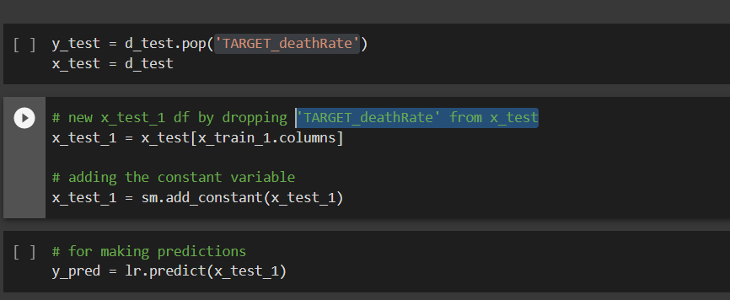
STEP 6: Making Predictions
The tasks performed are:
Splitting into x_test and y_test
New df is formed named x_test_1 by dropping 'TARGET_deathRate' from x_test
y_pred is declared to handle the predictions.

Slide 10
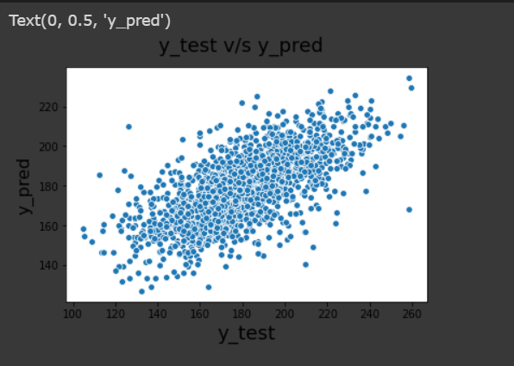
STEP 7: Model Evaluation
The tasks performed are:
A scatterplot is being plotted in order to show the variance of the y_test and y_pred values.
The final R-squared value is 0.486.

Slide 11
THANK YOU

